Slide 1
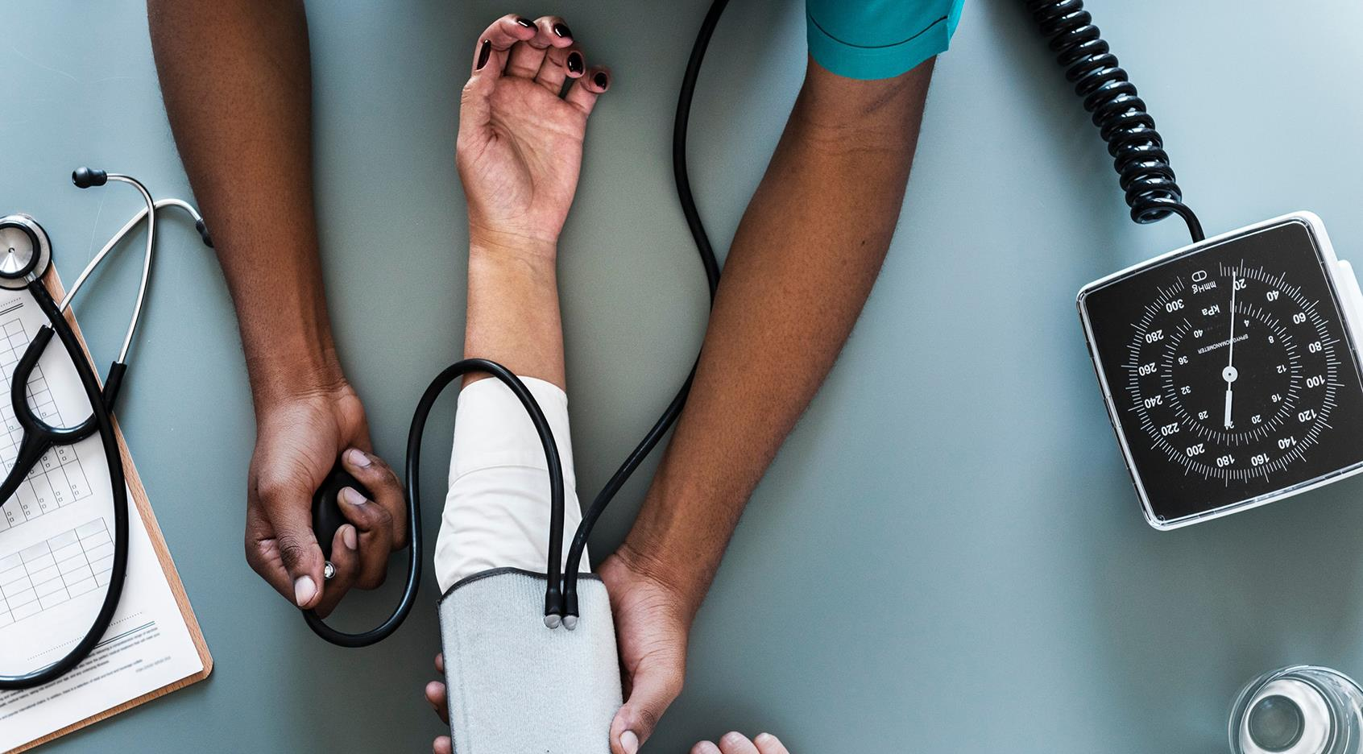

mediGO
-

Slide 2

Team Byte Karma
1) Palveet Kaur Saluja
2) Mrinmoy Paul
3) Utkarsh Akhouri
4) Shreyas Gawade
5)Prachi Jain

Slide 3

Problem Statement
People face various diseases due to the environmental condition and their
living habits. So the prediction of disease at earlier stage becomes the most important. Make a model which can help people to come out of this problem.

Slide 4
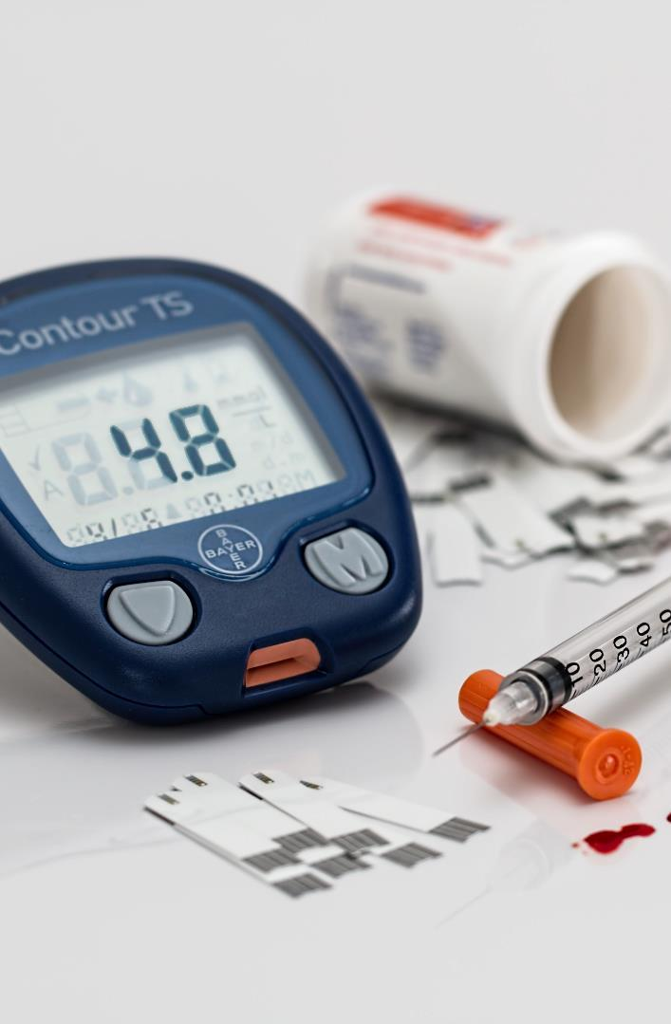
Solution
We are making a model where we will predict the disease by their symptoms.
The model will also show pharmacy and Hospitals near the user/patient so that no need for patient to search for hospitals and pharmacy.
So using this model , anyone can predict his/her Disease and can find hospital and pharmacy near their location.

Slide 5
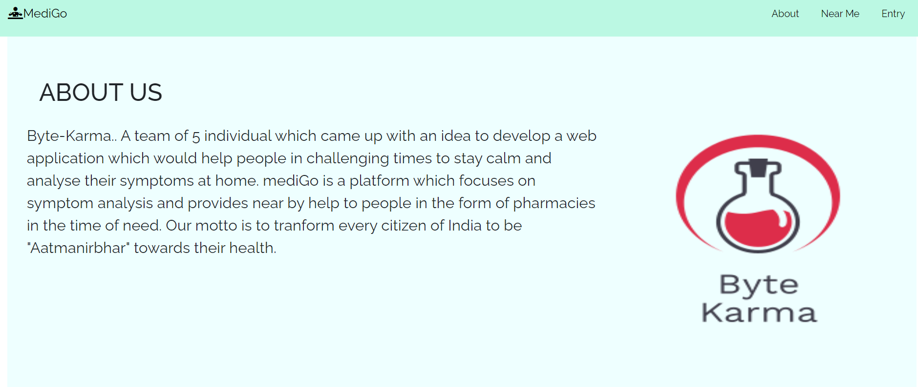
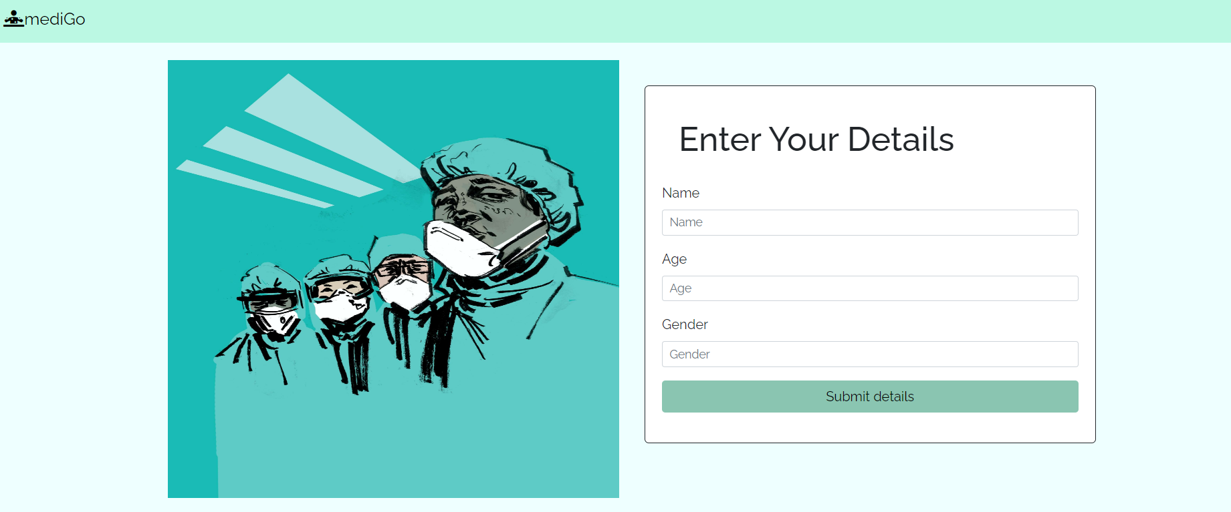
Progress
The frontend and backend of the project is completed and the ML model is tested successfully.
The final output of the symptom tracker is a predicted disease which the person suffers from.
The API gives the nearby hospital and pharmacy details to the user.

Slide 6
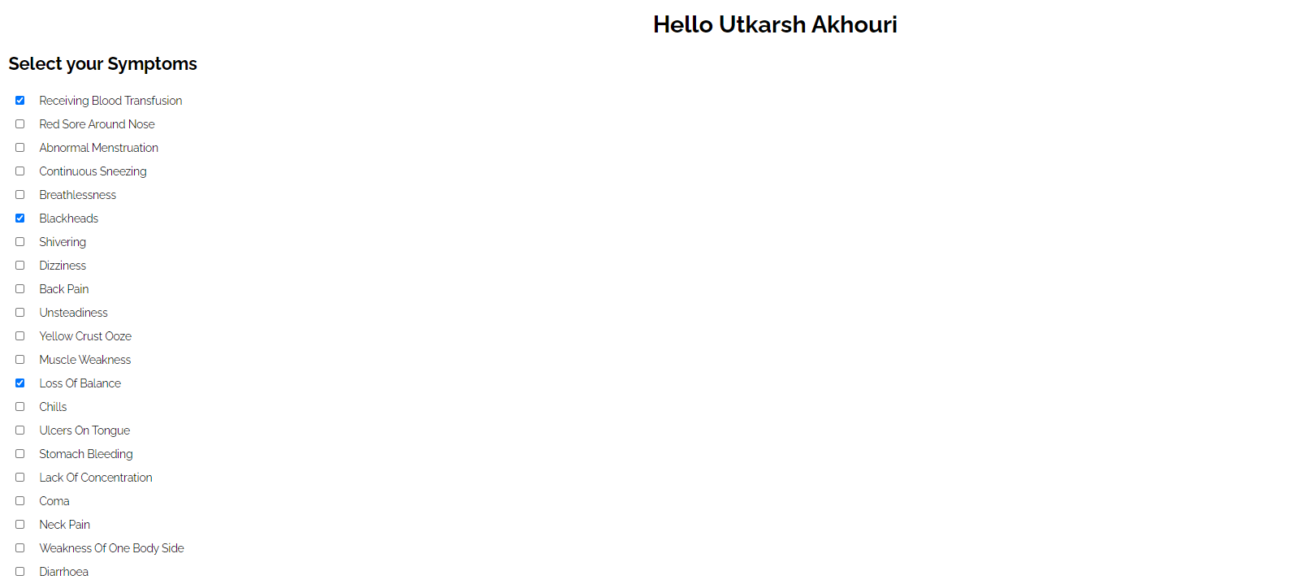
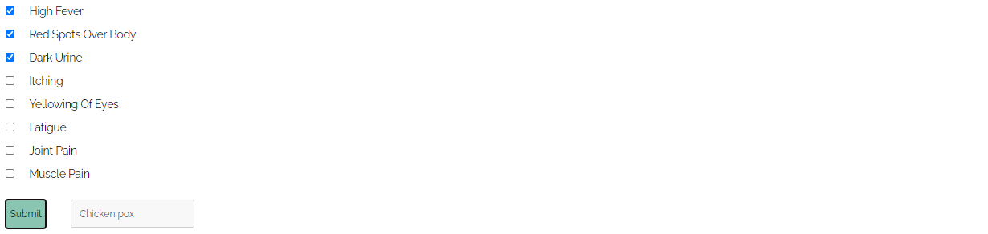
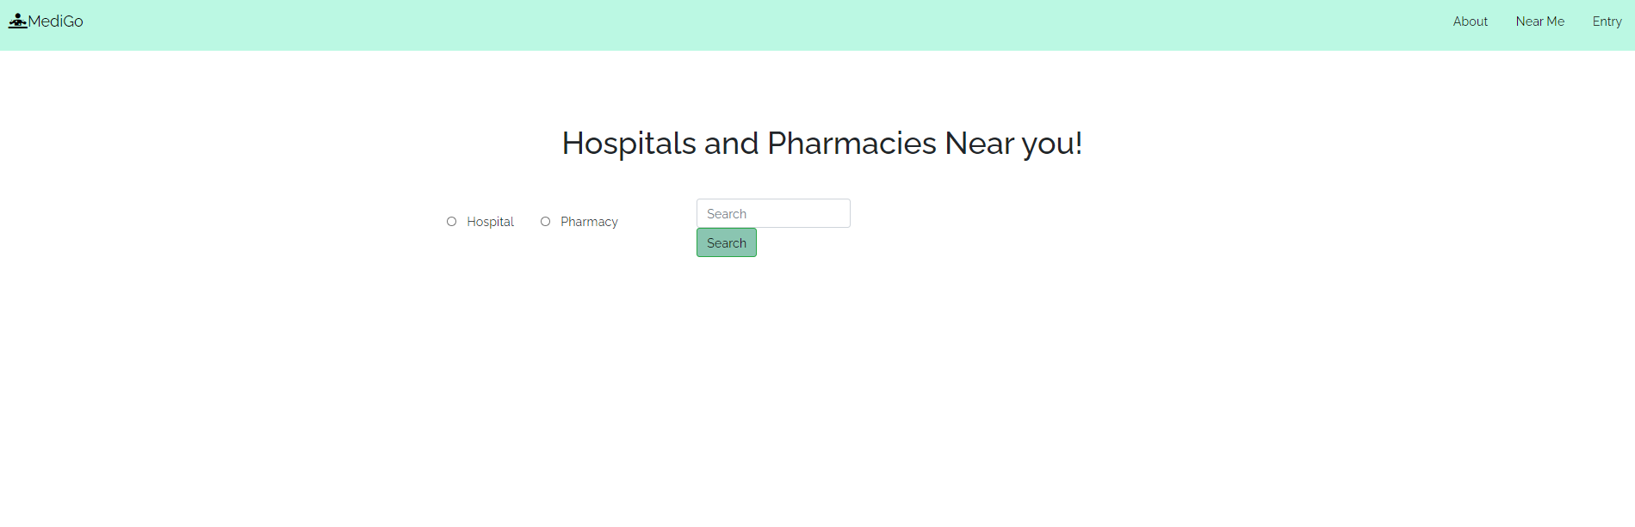
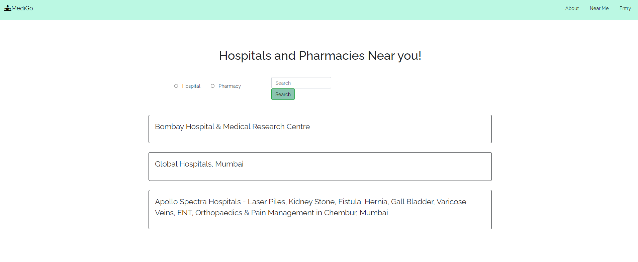

Slide 7

Competitors in Market
USP Of Project
With this model, we aim to help the users , diagnose themselves with a nice accuracy and help them to make better decisions regarding their personal health
User will be able to diagnose the diseases based upon their symptoms and they can also use this model for their family members..
This Model will do the better time management.
Webicina.
Smartpatients.
MedlinePlus.
Drugs.com
Generis
Teladoc
Better Help
MDacne

Slide 8

Link
Thank You
https://github.com/Palveet/Byte-Karma-HackChennai

